Slide 1

Workplace Attrition
Presented by:
Daanesh Ibrahim
Notes:
Hello, my name is Daanesh Ibrahim. I am member of the talent management team at DDS Analytics. Over this presentation I will take you through a brief overview of the Employee Attrition Analysis we conducted for your company and how we can minimize it going forward. We will also look at models to predict Monthly income.

Slide 2
Exploratory Analysis
Notes:
Let is go over some of the preliminary analysis gathered on the datasets you gave to us.

Slide 3
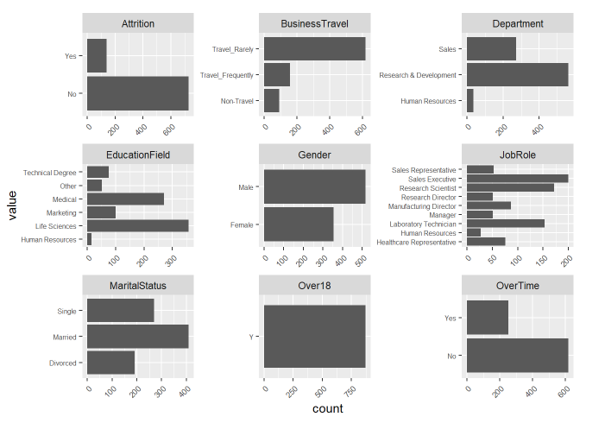
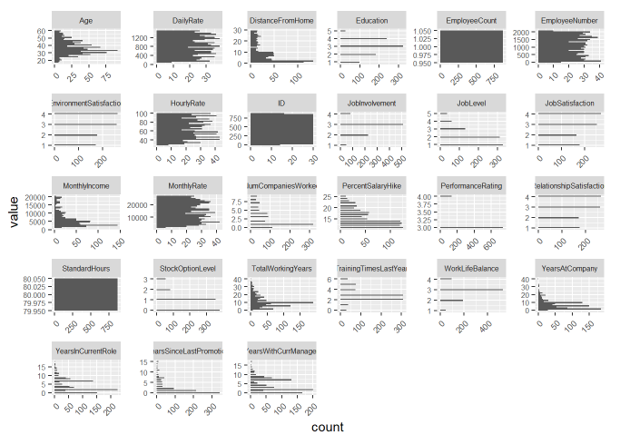
Bar Graphs and Histograms
Categorical (Factors)
Numeric (Integers)
Notes:
Right off the bat we can eliminate 3 columns due to them having the same value for every row: -
Over18 (‘Y’ in every row)
EmployeeCount (‘1’ in every row)
StandardHours (‘80’ in every row)

Slide 4
Bar Graphs and Histograms
Categorical (Factors)
Numeric (Integers)
Notes:
We also see that there are numerous variables seen as integers which should actually be seen as factors, or categorical:
Education
EnvironmentSatisfaction
JobInvolvement
JobLevel
JobSatisfaction
PerformanceRating
RelationshipSatisfaction
StockOptionLevel
TrainingTimesLastYear
WorkLifeBalance
We will change these variables to factors moving forward

Slide 5
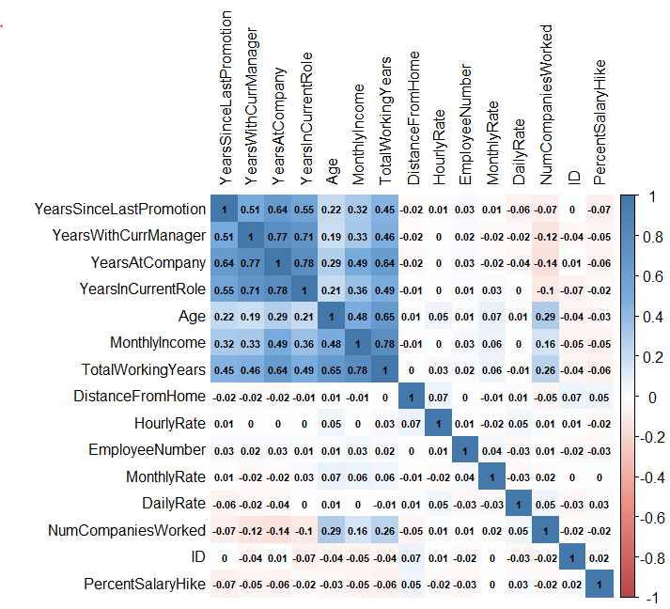
Correlated Numerical Predictors
Notes:
This Correlation Matrix shows us which numerical variables have a high correlation with one another. Notice that
TotalWorkingYears and YearsAtCompany are both highly correlated with each other with Age and YearsInCurrentRole respectively.
We will look at them later as a candidate for removal from our prediction models.

Slide 6
Finding Significant Factor Variables
Overall Attrition Rate: 16.1%
Factors with Strongest Impact on Attrition (Chi-Squared test, alpha = 0.05)
1) Overtime (p = 1.024e-15)
2) Stock Option Level (p = 3.724e-12)
3) Job Involvement (p = 5.211e-09)
4) Job Level (p = 2.085e-08)
5) Marital Status (p = 3.379e-08)
No Significant Impact (Chi-Squared test, alpha = 0.05)
Gender, Education, Daily/Hourly Rate, Monthly Income, Performance Rating, Relationship Satisfaction, and Time Allotted for Training
Notes:
Let us now look at the factors that have the most impact on Attrition. These factors were chosen by using a Chi Squared Test to test for significance with 95% confidence.
1) Overtime (p = 1.024e-15)
2) Stock Option Level (p = 3.724e-12)
3) Job Involvement (p = 5.211e-09)
4) Job Level (p = 2.085e-08)
5) Marital Status (p = 3.379e-08)
Were shown to be the factors that have the most impact on Attrition.

Slide 7
Finding Significant Factor Variables
Overall Attrition Rate: 16.1%
Factors with Strongest Impact on Attrition (Chi-Squared test, alpha = 0.05)
1) Overtime (p = 1.024e-15)
2) Stock Option Level (p = 3.724e-12)
3) Job Involvement (p = 5.211e-09)
4) Job Level (p = 2.085e-08)
5) Marital Status (p = 3.379e-08)
No Significant Impact (Chi-Squared test, alpha = 0.05)
Gender, Education, Daily/Hourly Rate, Monthly Income, Performance Rating, Relationship Satisfaction, and Time Allotted for Training
Notes:
These variables do not have a significant difference in the Attrition rate:
- Education Field
- Education (level)
- Gender of Employee
- Performance Rating
- Relationship Satisfaction
- Training Time
- Daily Rate
- Hourly Rate
- Monthly Income
- Years Since Last Promotion

Slide 8
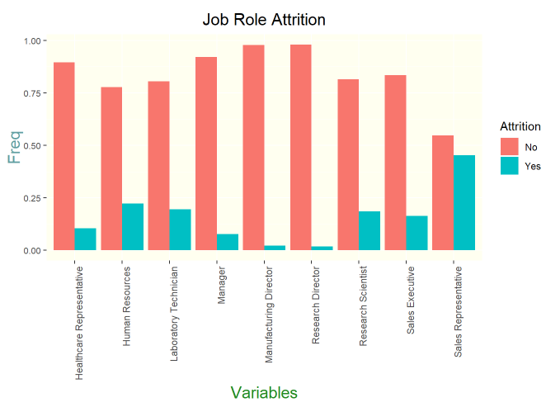
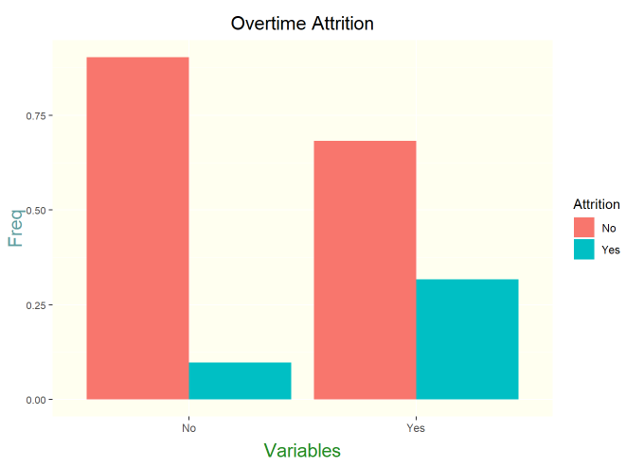
Finding Significant Factor Variables
Overall Attrition Rate: 16.1%
Factors with Strongest Impact on Attrition
1) Overtime (p = 1.024e-15)
2) Stock Option Level (p = 3.724e-12)
3) Job Involvement (p = 5.211e-09)
4) Job Level (p = 2.085e-08)
5) Marital Status (p = 3.379e-08)
Notes:
Looking at specific Job Roles of these Departments, it seems those with a leadership role (Directors, Managers, and Executives) have lower Attrition Rates than those who work under them (Representatives, Technicians, Research Scientists).
- This is holds true for for Overtime as well since the Leadership roles do not qualify for Overtime have a much lower Attrition Rate (9.71%) compared to those who do qualify for Overtime in Non-Leadership roles (31.75%).

Slide 9
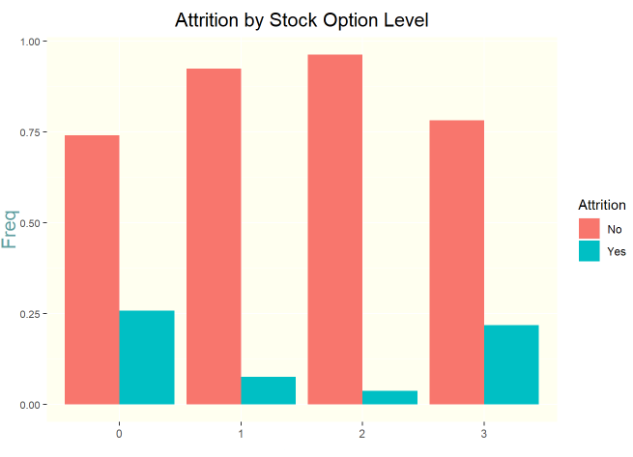
Finding Significant Factor Variables
Overall Attrition Rate: 16.1%
Factors with Strongest Impact on Attrition
1) Overtime (p = 1.024e-15)
2) Stock Option Level (p = 3.724e-12)
3) Job Involvement (p = 5.211e-09)
4) Job Level (p = 2.085e-08)
5) Marital Status (p = 3.379e-08)
Notes:
Attrition Rates are highest with employees who have no Stocks (StockLevel = 0) at (25.86%) or who have the most amount of stocks (Stock Level = 3) at (21.82%).

Slide 10
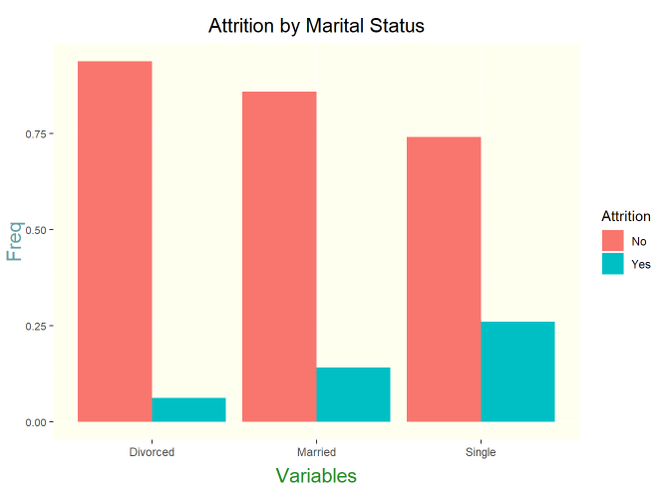
Finding Significant Factor Variables
Overall Attrition Rate: 16.1%
Factors with Strongest Impact on Attrition
1) Overtime (p = 1.024e-15)
2) Stock Option Level (p = 3.724e-12)
3) Job Involvement (p = 5.211e-09)
4) Job Level (p = 2.085e-08)
5) Marital Status (p = 3.379e-08)
Notes:
Looking at Attrition Rate for Divorcees vs the employees who are married or single, the Divorcees have the lowest Attrition Rate at 6.28%, while those who are married have a 14.15% Attrition Rate and the single employees have a 26.02% Attrition Rate.

Slide 11
Classification Model
Naive Bayes Model
Model 1
All variables included in this model
Model 2
Removed Variables that had high correlations with other columns as well as non significant variables
Model 3
Only included Variables that the Chi Squared Test deemed significant (p-value < 0.05)
Model 4
Same as Model 3, only we removed the 2 highly correlated columns we saw in the correlation matrix (TotalWorkingYears and YearsAtCompany)
Notes:
In order to predict Attrition, we have decided to use a Naïve Bayes Model. This will allow us to split our data into a training set and a test set. We will build the model with the training set and test the model’s ability on the test set. Whichever model has the lowest Root Mean Square Error while giving us atleast 60% Sensitivity and 60% Specificity will be the model we go with.

Slide 12
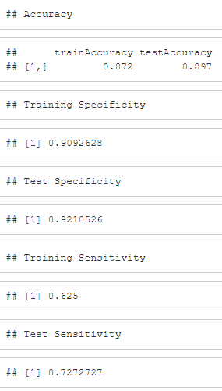
Classification Model
Naive Bayes Model
Model 4
Same as Model 3, only we removed the 2 highly correlated columns we saw in the correlation matrix (TotalWorkingYears and YearsAtCompany)
Notes:
Model 4 had the best Specificity (92.1%) and Sensitivity (72.27%). This will be the model we go with for Predicting Attrition.

Slide 13
Prediction Model
Linear Regression: Model Selection
Forward Selection
Backward Selection
Stepwise Selection
Notes:
Looking at the prediction model used to estimate MonthlyIncome from the validation file you gave us, we have decided to use one of these 3 models to do this.
Forward Selection
Backward Selection
Stepwise Selection
In order to do so, we need to find out how many variables to use. This can become tedious, so using code we can give the model a range of which number of columns it can use in order of the best (lowest) p-values according to Monthly income. The model will give us the RMSE of each time it adds a variable.
The RMSE is basically just the standard deviation of the residuals (which are our predicted errors) so we want that number to be as small as possible.
At some point, the RMSE will cease to decrease and begin increasing. This is the “sweet spot” in terms of number of variables the model will use. Whichever model has the lowest RMSE is the model we will go with.

Slide 14
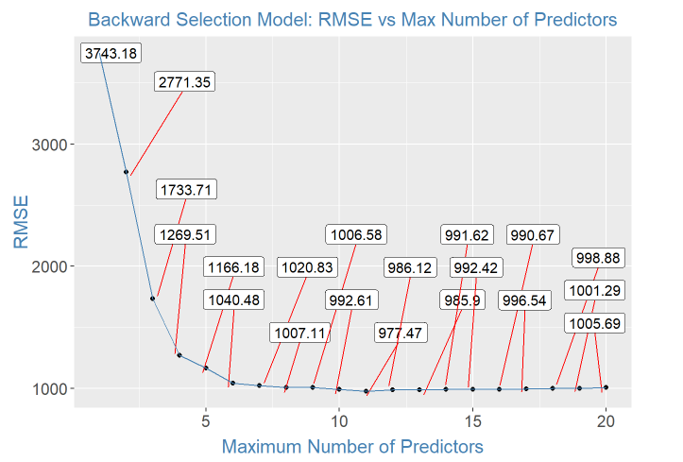
Prediction Model
Linear Regression: Model Selection
Backward Selection
Notes:
After running the model through the training data we were given, it has been determined that the Backward Model has the lowest RMSE at around 11 variables as seen here.
The RMSE at 11 Predictors is 977.47. We will use the Backward Model to predict Monthly Income for the Validation file

Slide 15
Takeaways
Naive Bayes for predicting Attrition
Multiple Linear Regression, more specifically Backward Selection, should be used to predict Monthly Income
There are some variables you see as numeric which should really be seen as factors
In terms of significance, Employees that are not exempt from Overtime are at a much greater risk of Attrition than those who are exempt (managers, directors, etc.)
Many variables can overlap and eliminating them can improve your models while also preventing overfitting.

Slide 16
Presentation Documentation
YouTube video for PowerPoint
https://www.youtube.com/watch?v=bYyacNZ_bKM
GitHub repository for Project
https://github.com/daaneshi/CaseStudy2DDS

